Slide 1




Be The Painter Final Project App User Manual
By Myra Multani

Slide 2



overview
Acknowledgements
About Me
About My Internship
About app
How to use the app?
Dependencies
Contact Person
Thank you

Slide 3

acknowledgements
I would like to thank my teacher Ms Mani for helping me when i got stuck while doing this and i would like to thank my parents for letting me do this internship to help me learn and grow. I would like to thank snap for adding help buttons so that i can use them.

Slide 4
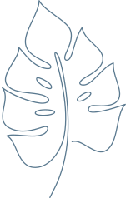
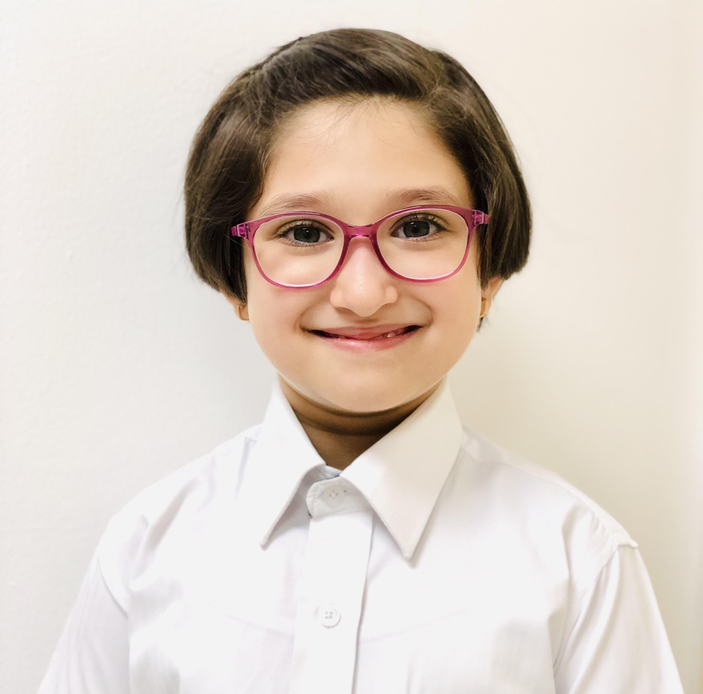
about me :
Hello! My name is Myra! I am 11 years old and i am going to grade 6! My hobbies are Reading, Art and listening to music. I enjoy doing coding because it helps me learn a new skill. I am from india. My favourite subject in school is art and math!

Slide 5

about my internship:
I enjoyed doing my internship with clevered. It was very fun and enjoyable because my teacher helped me out a lot and taught me new topics in coding and i liked making projects on snap.I have recieved the Rockstar Badge for Attentiveness and Rockstar Badge for Team work

Slide 6
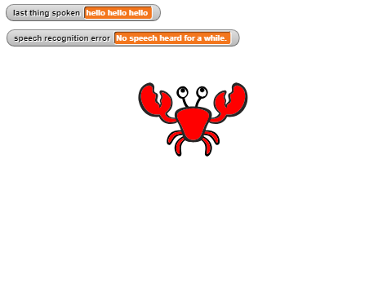

about app
My app be the painter is an app which uses voice recognition to make shapes. It can make a circle, square, rectangle , pentagon, triangle, heart and a star. It will only draw if you pronounce the word correctly or in a voice which it will understand it in .

Slide 7

How to use the app?
1, Open the file of the app on snap
2, Make sure your voice is clear, your mic is working properly, and use the correct pronunciation and tone.
3. It will only work when you say the word itself like “heart” not “a heart”.
4. Speak the shape you want it to make!
5. Done! Your shape is made! If you want to do it again, follow the same steps and reset!

Slide 8

Any special considerations / Dependencies
*Good internet connection
*SNAP! platform - https://snap.berkeley.edu/
*Proper System Mic
*Device which supports snap and speech recognition

Slide 9
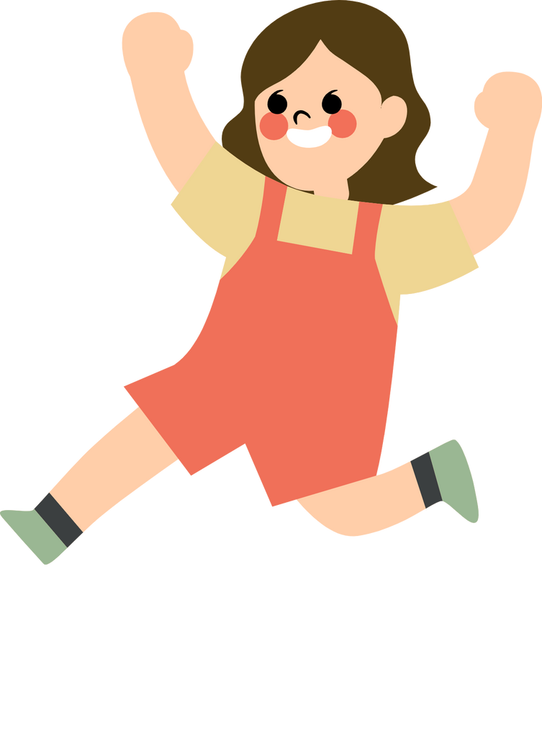

Contact Person
Please reach out to Myra at
myramultani@icloud.com for any questions/
concerns/ suggestions on the App

Slide 10


Thank
You

